Slide 1
Comprehensive Guide to Evaluating LLM and RAG Systems
Dipanjan (DJ) Sarkar

Slide 2
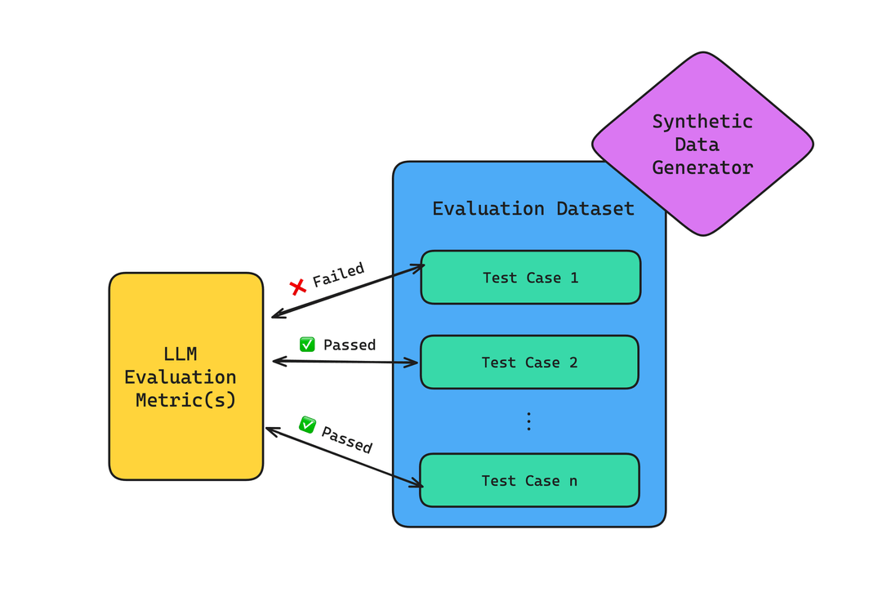
Building an LLM Evaluation Framework
An LLM Evaluation Framework is designed to evaluate and test outputs of LLM systems on a range of different criteria
Key components of this framework would be:
An evaluation dataset typically of (context), input and output pairs or triplets
Evaluation metrics which we want to use to measure the performance of our system
Source: https://www.confident-ai.com/blog/llm-evaluation-metrics-everything-you-need-for-llm-evaluation

Slide 3
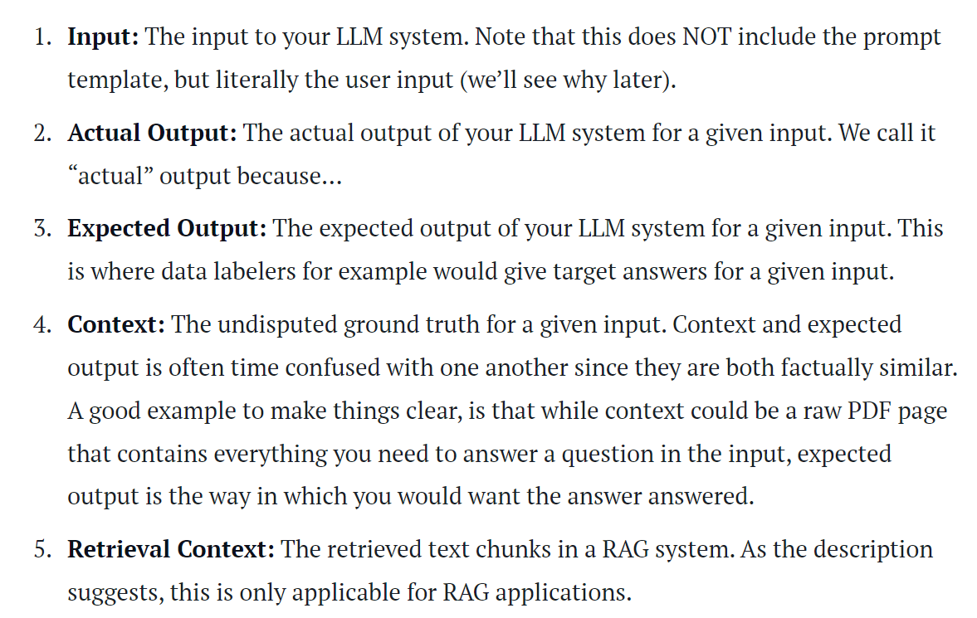
Typical components of a Test Case data point
Source: https://www.confident-ai.com/blog/llm-evaluation-metrics-everything-you-need-for-llm-evaluation

Slide 4
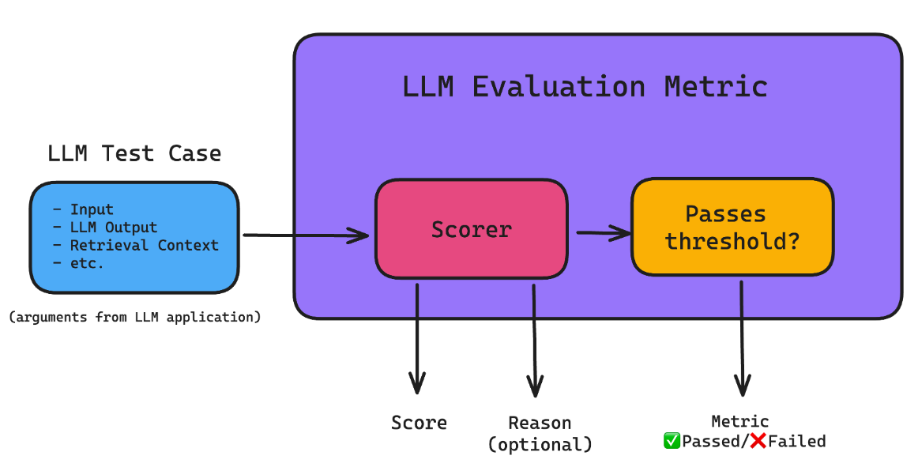
LLM Evaluation Metrics
LLM evaluation metrics such as answer correctness, semantic similarity, relevancy are measures that help in scoring your LLM system’s output based on criteria you care about
Helps in quantifying the performance of your LLM or RAG system
Source: https://www.confident-ai.com/blog/llm-evaluation-metrics-everything-you-need-for-llm-evaluation

Slide 5
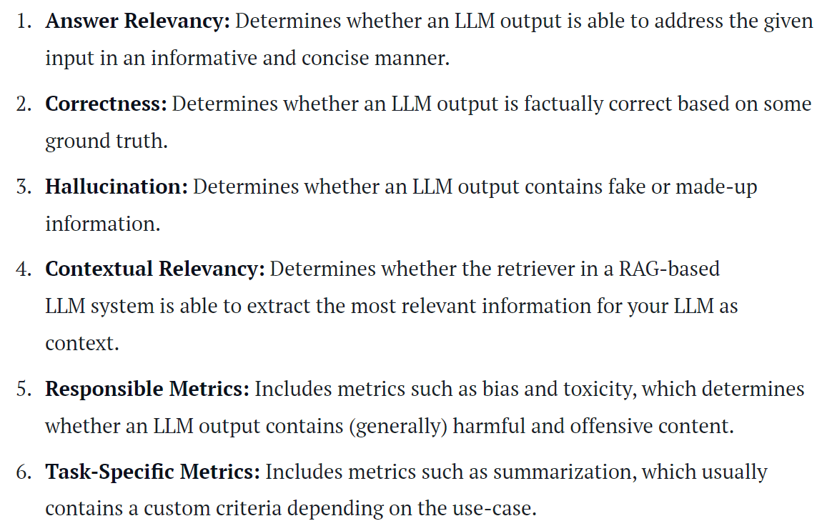
Most Popular LLM Evaluation Metrics
Source: https://www.confident-ai.com/blog/llm-evaluation-metrics-everything-you-need-for-llm-evaluation

Slide 6
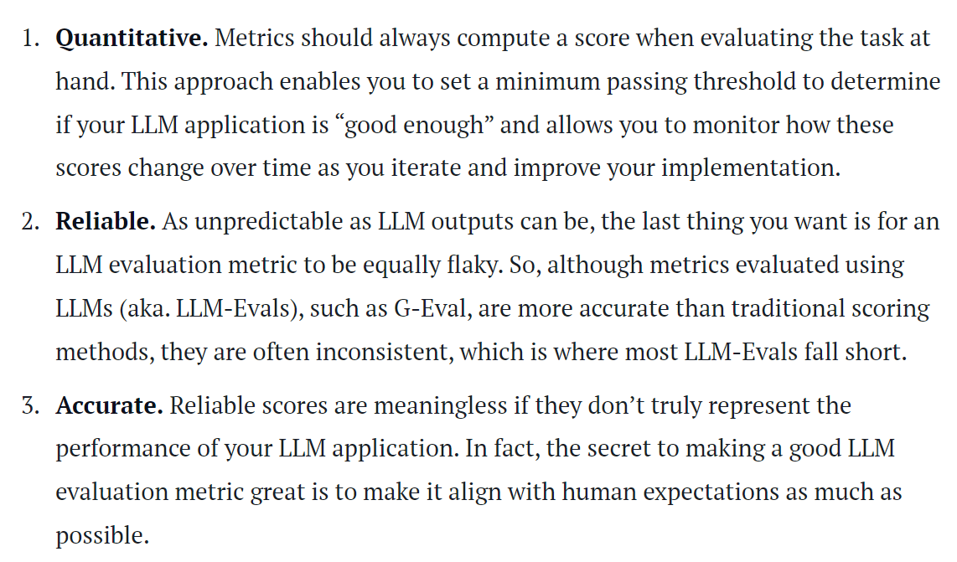
What makes an Evaluation Metric Good to Use?
Source: https://www.confident-ai.com/blog/llm-evaluation-metrics-everything-you-need-for-llm-evaluation

Slide 7
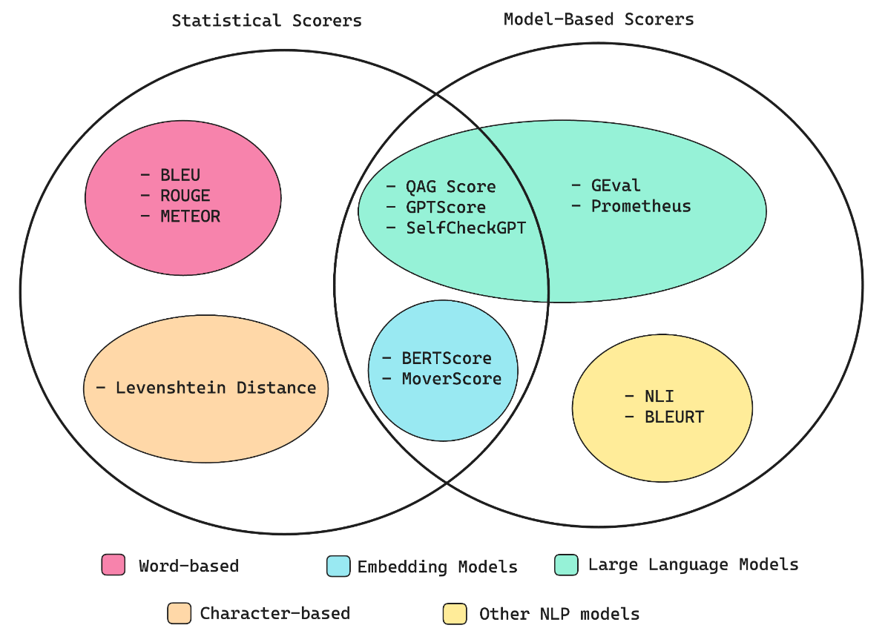
Common Evaluation Metric Scorers
Source: https://www.confident-ai.com/blog/llm-evaluation-metrics-everything-you-need-for-llm-evaluation

Slide 8
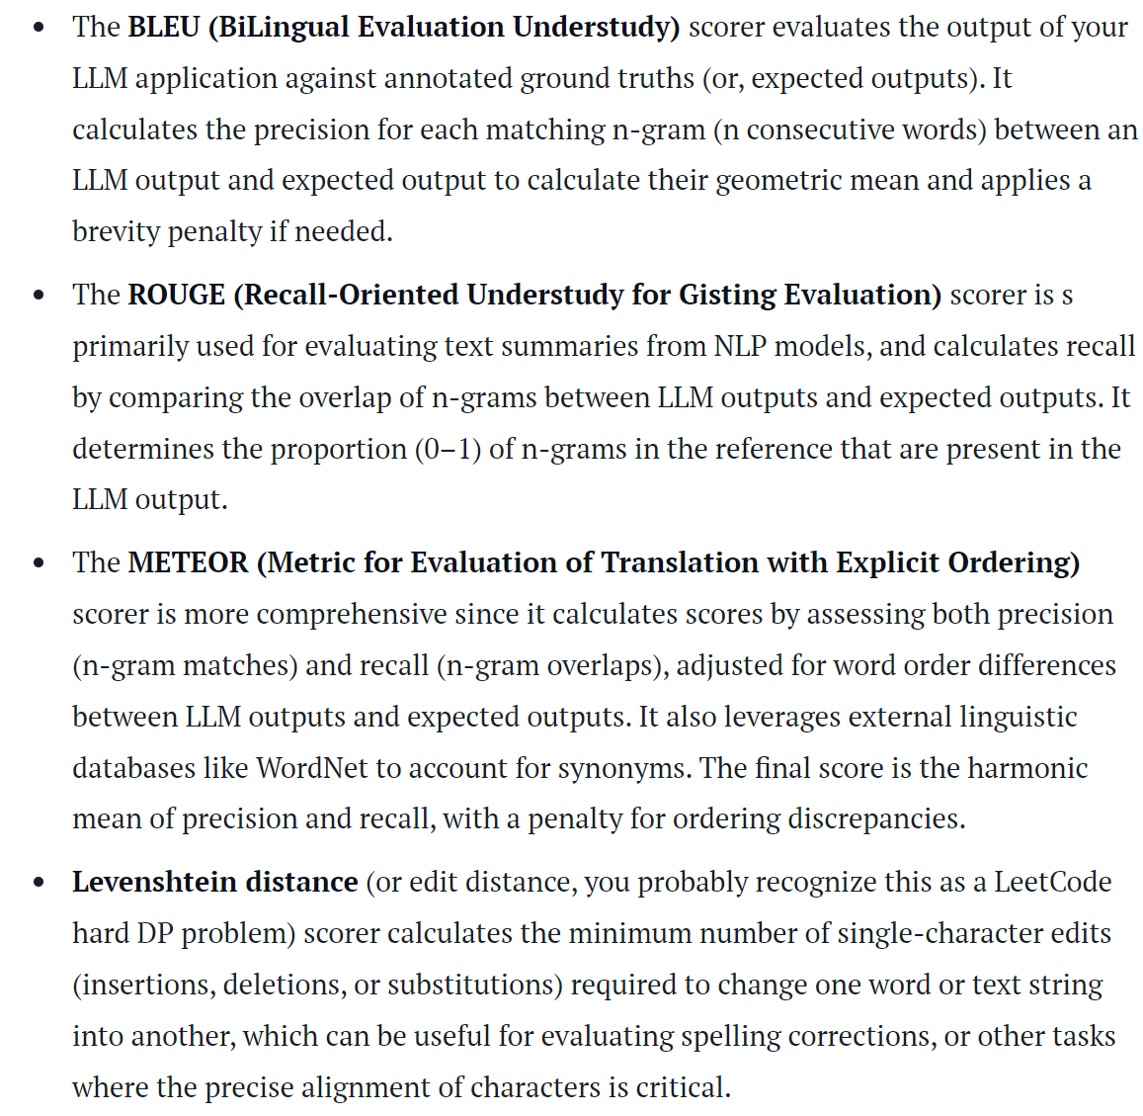
Statistical Metric Scorers
Source: https://www.confident-ai.com/blog/llm-evaluation-metrics-everything-you-need-for-llm-evaluation

Slide 9
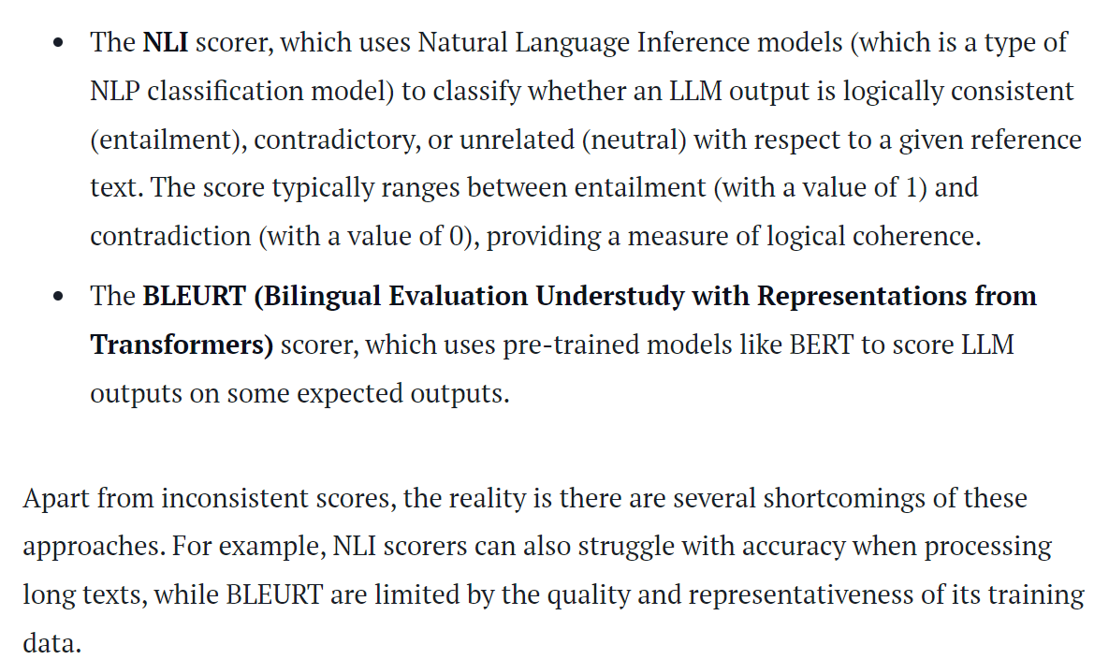
Model-based Non-LLM Scorers
Source: https://www.confident-ai.com/blog/llm-evaluation-metrics-everything-you-need-for-llm-evaluation

Slide 10
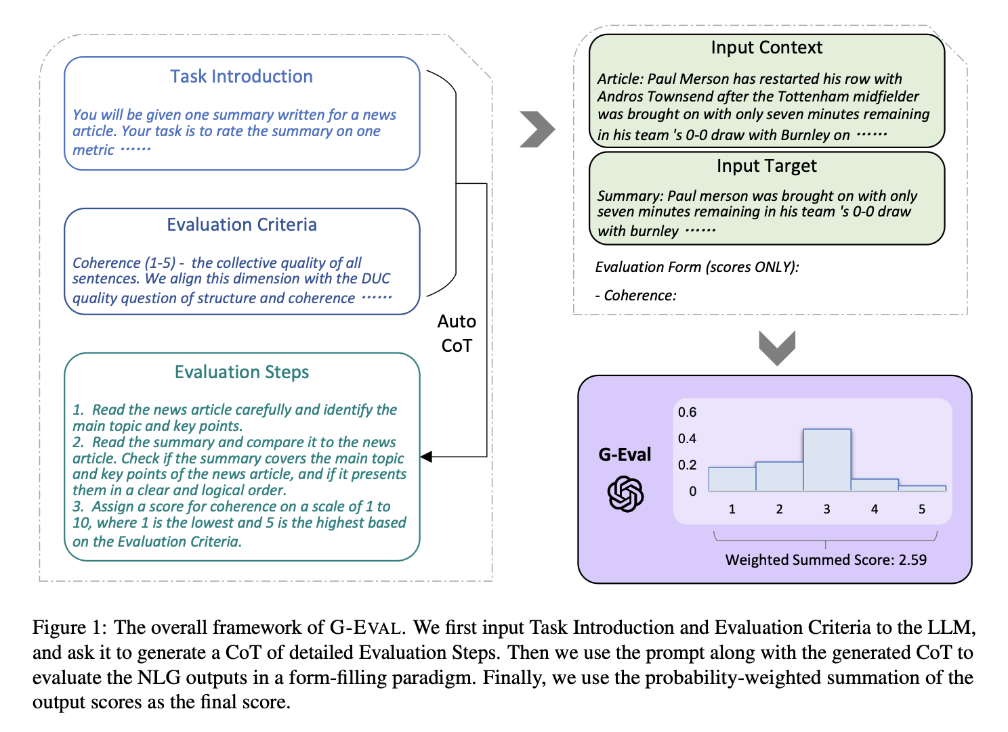
Model-based LLM Scorers - G-Eval
G-Eval first generates a series of evaluation steps using chain of thoughts (CoTs) before using the generated steps to determine the final score via a form-filling paradigm
Source: https://www.confident-ai.com/blog/llm-evaluation-metrics-everything-you-need-for-llm-evaluation

Slide 11
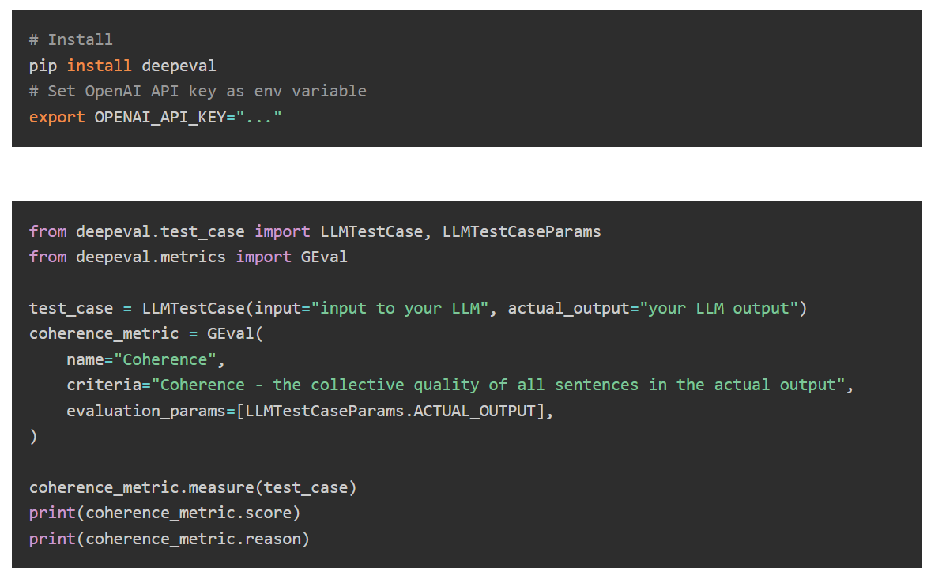
G-Eval with DeepEval
Source: https://www.confident-ai.com/blog/llm-evaluation-metrics-everything-you-need-for-llm-evaluation

Slide 12
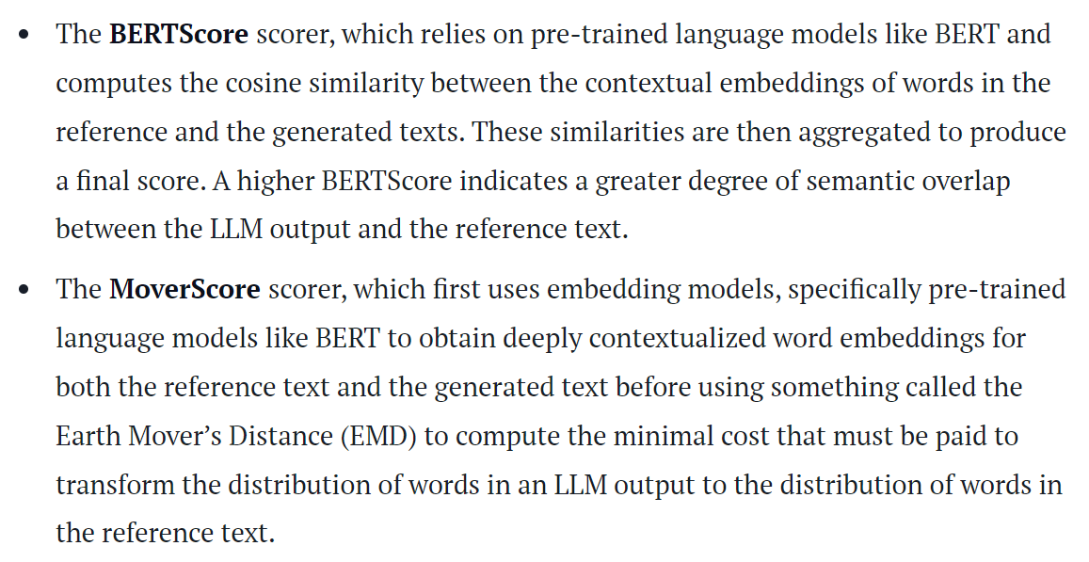
Combining Statistical and Model-based Scorers
Source: https://www.confident-ai.com/blog/llm-evaluation-metrics-everything-you-need-for-llm-evaluation

Slide 13
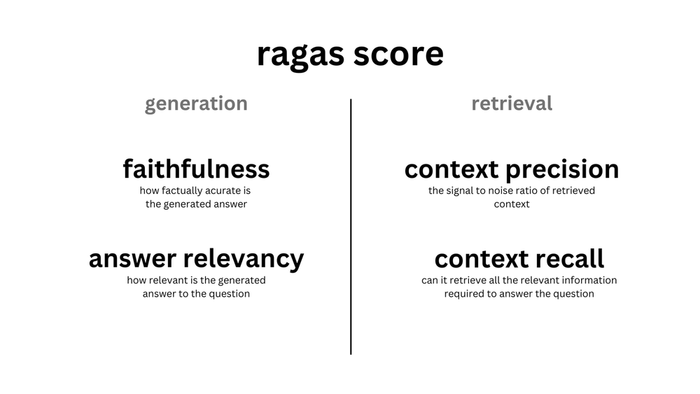
Ragas for evaluating LLM and RAG Systems
Ragas is a framework that helps you evaluate your Retrieval Augmented Generation (RAG) pipelines
Very useful as it provides a suite of metrics to evaluate each stage of a RAG pipeline
Source: https://docs.ragas.io/en/stable/index.html

Slide 14
Key Metrics for RAG Evaluation
Metrics to evaluate specific components of a RAG pipeline include:
Faithfulness
Answer Relevance
Context Precision
Context Relevancy
Context Recall
Context entities recall
Metrics to evaluate the entire LLM or RAG system include:
Answer semantic similarity
Answer Correctness
Source: https://docs.ragas.io/en/stable/index.html

Slide 15
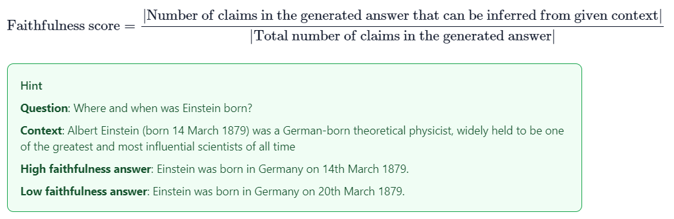
Faithfulness
Measures the factual consistency of the generated answer against the given context
Calculated from answer and retrieved context
Answer is scaled to (0,1) range. Higher the better
Source: https://docs.ragas.io/en/stable/index.html

Slide 16
Faithfulness
Generated answer is regarded as faithful if all the claims made in the answer can be inferred from the given context
Uses the formula as shown on the left
Source: https://docs.ragas.io/en/stable/index.html

Slide 17
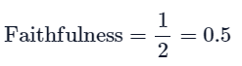
Faithfulness
Let’s examine how faithfulness was calculated using the low faithfulness answer:
Step 1: Break the generated answer into individual statements.
Statement 1: “Einstein was born in Germany.”
Statement 2: “Einstein was born on 20th March 1879.”
Step 2: For each of the generated statements, verify if it can be inferred from the given context.
Statement 1: Yes
Statement 2: No
Step 3: Use the formula depicted above to calculate faithfulness.
Source: https://docs.ragas.io/en/stable/index.html

Slide 18
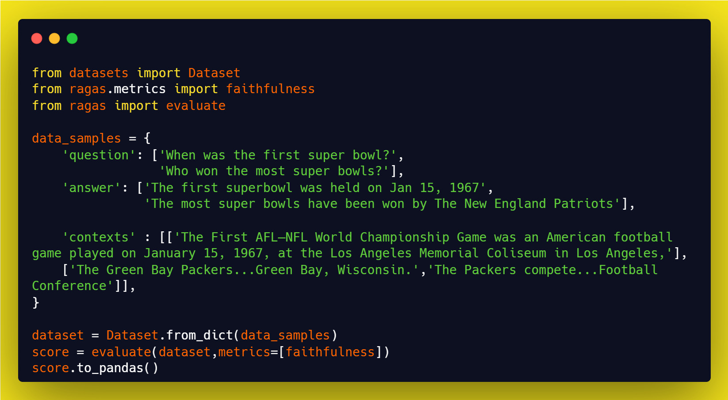
Faithfulness in Ragas
Source: https://docs.ragas.io/en/stable/index.html

Slide 19
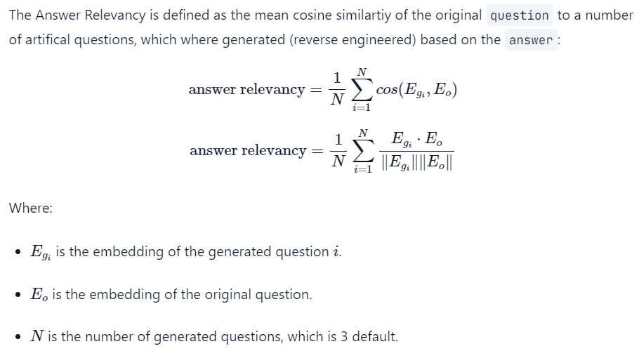
Answer Relevance
Answer Relevancy, focuses on assessing how pertinent or relevant the generated answer is to the given prompt
Lower score is assigned to answers that are incomplete or contain redundant information and higher scores indicate better relevancy
Metric is computed using the question, the context and the answer
Source: https://docs.ragas.io/en/stable/index.html

Slide 20
Answer Relevance
To calculate this score, the LLM is prompted to generate an appropriate question for the generated answer multiple times
The mean cosine similarity between these generated questions and the original question is measured
If the generated answer accurately addresses the initial question, the LLM should be able to generate questions from the answer that align with the original question
Source: https://docs.ragas.io/en/stable/index.html

Slide 21
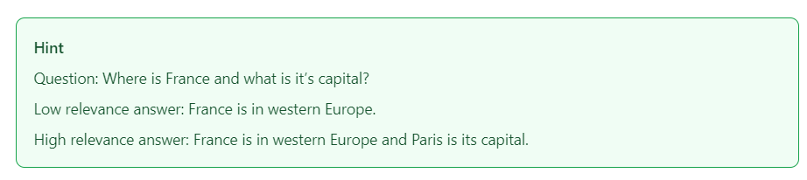
Answer Relevance
To calculate the relevance of the answer to the given question, we follow two steps:
Step 1: Reverse-engineer ‘n’ variants of the question from the generated answer using a Large Language Model (LLM). For instance, for the first answer, the LLM might generate the following possible questions:
Question 1: “In which part of Europe is France located?”
Question 2: “What is the geographical location of France within Europe?”
Question 3: “Can you identify the region of Europe where France is situated?”
Step 2: Calculate the mean cosine similarity between the generated questions and the actual question.
Source: https://docs.ragas.io/en/stable/index.html

Slide 22
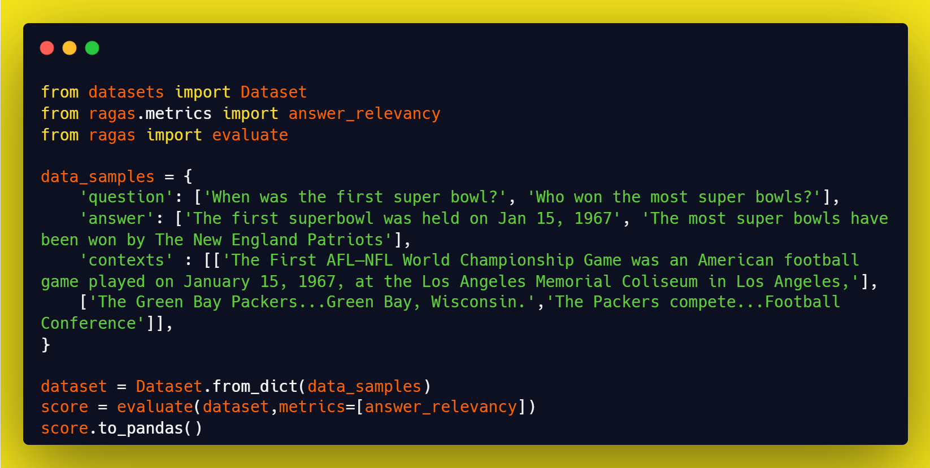
Answer Relevance in Ragas
Source: https://docs.ragas.io/en/stable/index.html

Slide 23
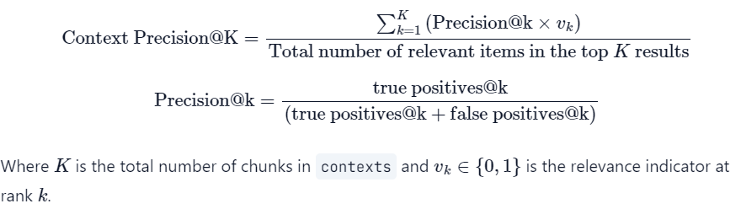
Context Precision
Metric that evaluates whether all of the ground-truth relevant items present in the contexts are ranked higher or not
Ideally all the relevant chunks must appear at the top ranks
This metric is computed using the question, ground_truth and the contexts
Higher score is better
Source: https://docs.ragas.io/en/stable/index.html

Slide 24

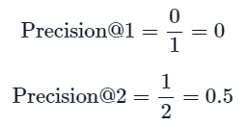
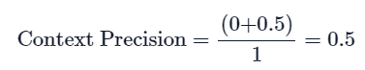
Context Precision
To calculate context precision in the low context precision example:
Step 1: For each chunk in retrieved context, check if it is relevant or not relevant to arrive at the ground truth for the given question.
Step 2: Calculate precision@k for each chunk in the context.
Step 3: Calculate the mean of precision@k to arrive at the final context precision score.
Source: https://docs.ragas.io/en/stable/index.html

Slide 25
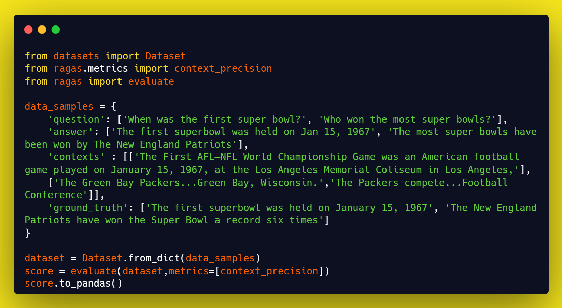
Context Precision in Ragas
Source: https://docs.ragas.io/en/stable/index.html

Slide 26

Context Relevancy
Metric gauges the relevancy of the retrieved context, calculated based on both the question and contexts
Retrieved context should exclusively contain essential information to address the provided query
We initially estimate the value of |S| by identifying sentences within the retrieved context that are relevant for answering the given question and use the formula on the left
Higher scores indicate better relevancy
Source: https://docs.ragas.io/en/stable/index.html

Slide 27

Context Relevancy
To calculate context relevancy in the given example:
Step 1: For any context document find out the number of sentences |S| which are relevant to the question
Step 2: Count total sentences in the retrieved context |T|
Step 3: Score is |S| / |T|
Source: https://docs.ragas.io/en/stable/index.html

Slide 28
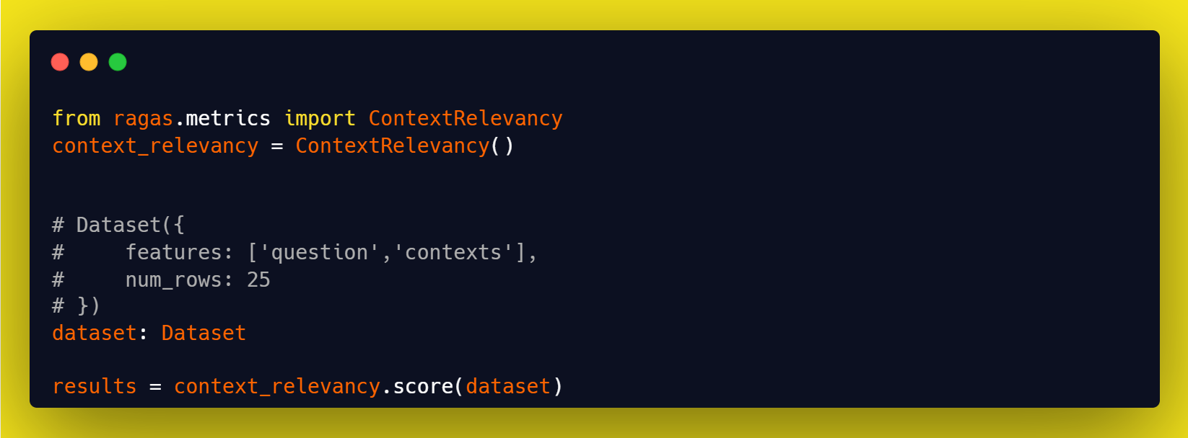
Context Relevancy in Ragas
Source: https://docs.ragas.io/en/stable/index.html

Slide 29
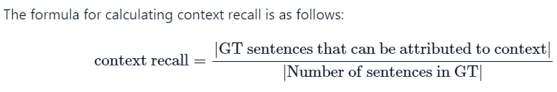
Context Recall
Measures the extent to which the retrieved context aligns with the annotated answer, treated as the ground truth
Computed based on the ground truth and the retrieved context
Each sentence in the ground truth answer is analyzed to determine whether it can be attributed to the retrieved context or not
Higher Score is better
Source: https://docs.ragas.io/en/stable/index.html

Slide 30

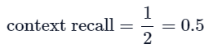
Context Recall
To calculate context recall in the low context recall example:
Step 1: Break the ground truth answer into individual statements.
Statement 1: “France is in Western Europe.”
Statement 2: “Its capital is Paris.”
Step 2: For each of the ground truth statements, verify if it can be attributed to the retrieved context.
Statement 1: Yes
Statement 2: No
Step 3: Use the formula to calculate context recall.
Source: https://docs.ragas.io/en/stable/index.html

Slide 31
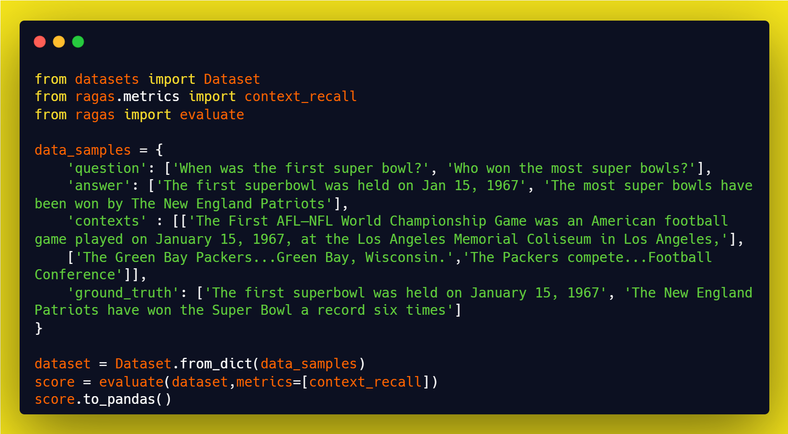
Context Recall in Ragas
Source: https://docs.ragas.io/en/stable/index.html

Slide 32
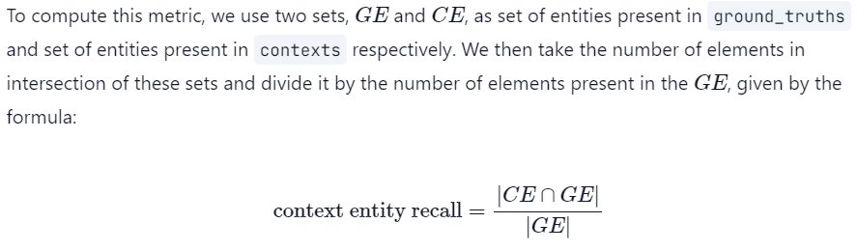
Context entities Recall
Metric gives the measure of recall of the retrieved context, based on the number of entities present in both ground_truths and contexts relative to the number of entities present in the ground_truths alone
Simply, it is a measure of what fraction of entities are recalled from ground_truths
It can help evaluate the retrieval mechanism for entities, based on comparison with entities present in ground_truths
Higher Score is better
Source: https://docs.ragas.io/en/stable/index.html

Slide 33

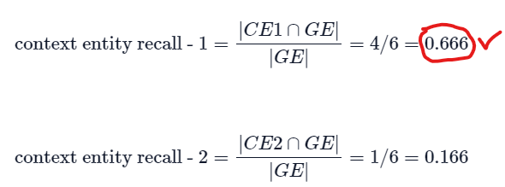
Context entities Recall
To calculate context entity recall in the given examples:
Step 1: Find entities present in the ground truths.
Entities in ground truth (GE) - [‘Taj Mahal’, ‘Yamuna’, ‘Agra’, ‘1631’, ‘Shah Jahan’, ‘Mumtaz Mahal’]
Step 2: Find entities present in the context.
Entities in context (CE1) - [‘Taj Mahal’, ‘Agra’, ‘Shah Jahan’, ‘Mumtaz Mahal’, ‘India’]
Entities in context (CE2) - [‘Taj Mahal’, ‘UNESCO’, ‘India’]
Step 3: Use the formula to calculate context entity recall.
Source: https://docs.ragas.io/en/stable/index.html

Slide 34
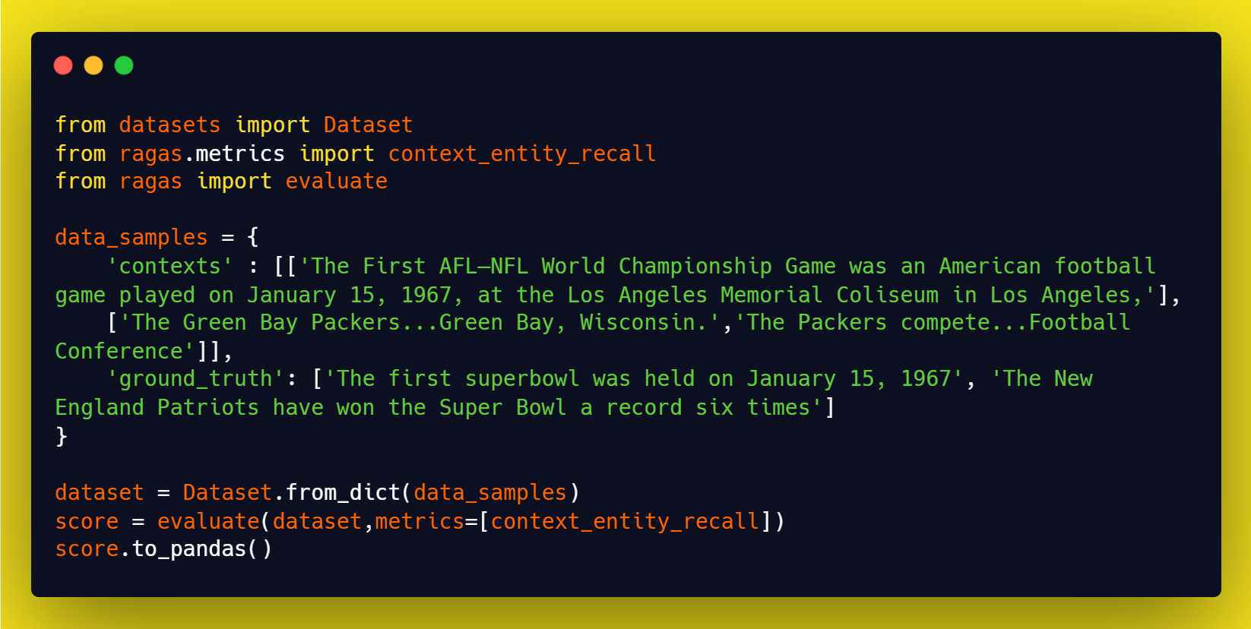
Context entities Recall in Ragas
Source: https://docs.ragas.io/en/stable/index.html

Slide 35
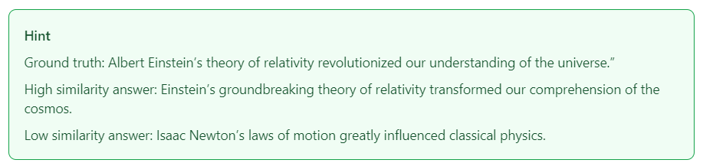
Answer semantic similarity
Answer Semantic Similarity pertains to the assessment of the semantic resemblance between the generated answer and the ground truth
This evaluation is based on the ground truth and the answer, with values falling within the range of 0 to 1
A higher score signifies a better alignment between the generated answer and the ground truth
Ragas utilizes a cross-encoder model to calculate the semantic similarity score using cosine similarity of the text embeddings
Source: https://docs.ragas.io/en/stable/index.html

Slide 36
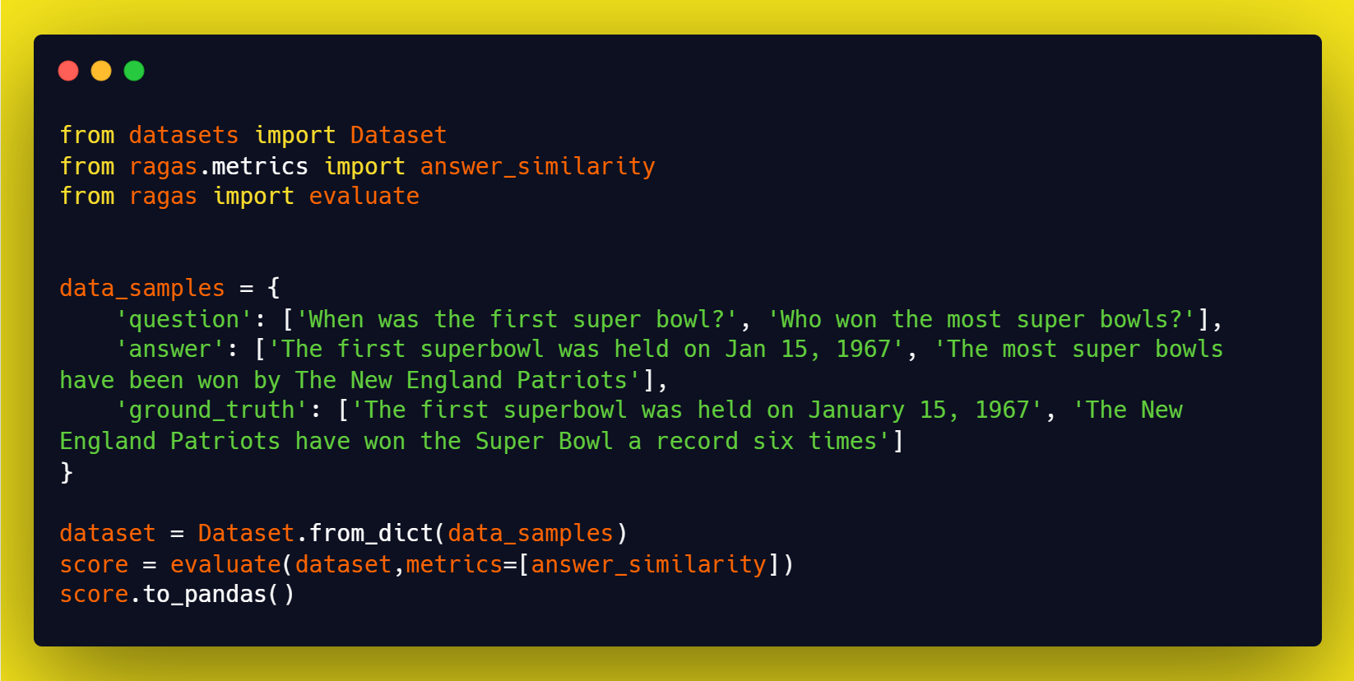
Answer semantic similarity in Ragas
Source: https://docs.ragas.io/en/stable/index.html

Slide 37
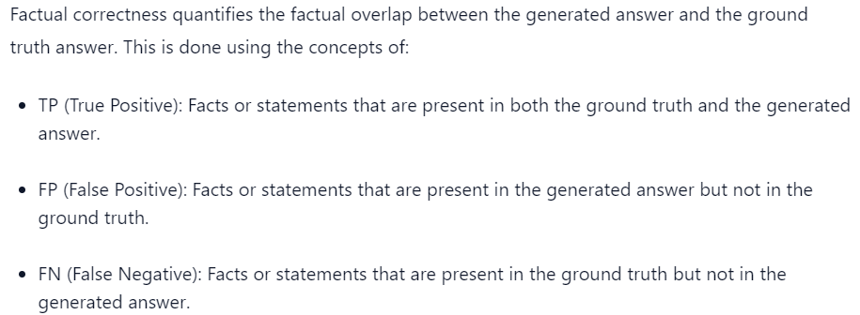
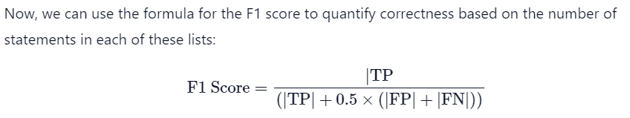
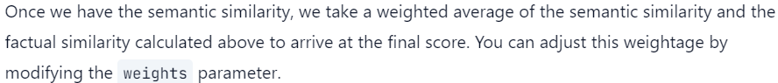
Answer Correctness
Answer Correctness involves gauging the accuracy of the generated answer when compared to the ground truth
This evaluation relies on the ground truth and the answer, with scores ranging from 0 to 1
Answer correctness encompasses two critical aspects
Factual similarity
Semantic similarity between the generated answer and the ground truth
Final score is a weighted average
Source: https://docs.ragas.io/en/stable/index.html

Slide 38
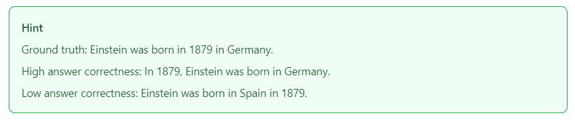
Answer Correctness
It is computed as the weighted sum \ average of factual correctness and the semantic similarity between the given answer and the ground truth
Factual correctness quantifies the factual overlap between the generated answer and the ground truth answer
In the second example:
TP: [Einstein was born in 1879]
FP: [Einstein was born in Spain]
FN: [Einstein was born in Germany]
We then calculate F1 score using the formula mentioned before
Then we calculate cosine similarity between the generated answer and the ground truth
Answer correctness is the weighted average of the above two metrics
Source: https://docs.ragas.io/en/stable/index.html

Slide 39
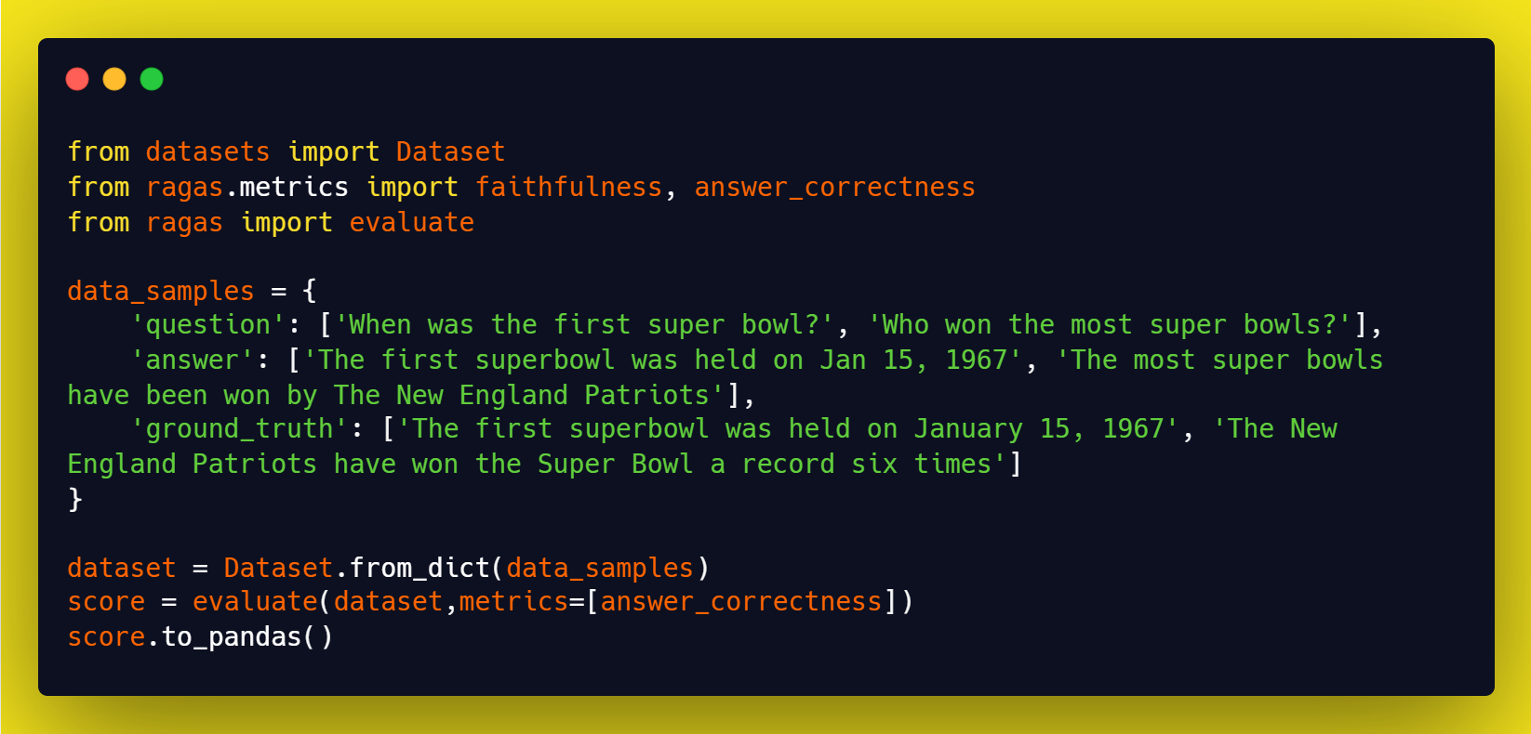
Answer Correctness in Ragas
Source: https://docs.ragas.io/en/stable/index.html

Slide 40

Aspect Critique
This is designed to assess submissions based on predefined aspects such as harmlessness and correctness
Users have the flexibility to define their own aspects for evaluating submissions according to their specific criteria
The output of aspect critiques is binary, indicating whether the submission aligns with the defined aspect or not.
This evaluation is performed using the ‘answer’ as input.
Source: https://docs.ragas.io/en/stable/index.html

Slide 41
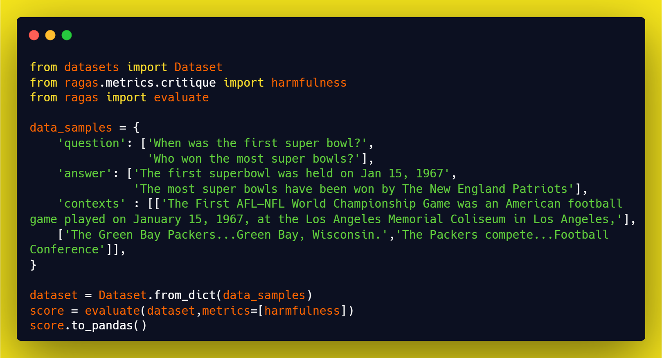
Aspect Critique in Ragas
Source: https://docs.ragas.io/en/stable/index.html

